Slide 1
IoT Based Emergency system for Women Safety

Slide 2
Abstract
Security is the condition of being protected against danger or loss. In the general sense, security is a concept similar to safety. The word "security" in general usage is synonymous with "safety," but as a technical term "security" means that something not only is secure but that it has been secured.
Women safety is a very important issue due to rising crimes against women these days especially in India. To help resolve this issue we propose a GPS based women’s safety system that has a security feature. This device consists of a system that ensures alerts in case a woman is harassed or she thinks she is in trouble or if she feels unsafe around an environment.

Slide 3
Introduction
In the past, codes like *91# were used to send alerts to the police.
Later, a mobile app was developed to send location to the nearest police station, but it had issues for elderly users and required a reliable network.
A wearable device with a buzzer was introduced for emergencies. To avoid smartphones, an Arduino-based system with GPS and GSM modules was created to send alerts to predefined numbers.
More recently, an ESP32-based wearable device allows users to send their location to parents and also functions as a fitness band.
And in this project, we have mainly used ESP32 to create a reliable emergency alert system. It enables users to send their location to predefined contacts during an emergency, without relying on smartphones.

Slide 4
Literature survey #1
Dr. C K Gomathy et al., of Sri Chandrasekharendra SaraswathiViswa Mahavidyalaya (2021) proposed the project which presents a wearable safety device for women using the Arduino. The purpose of this device is to safeguard women in the event they might face any danger. The device uses wireless sensor network to communicate and to send alerts to them. The GPS and GSM are used to share the used to share the user’s location directly to the relevant authorities and saved contacts. The switch in the device work for sending manual alerts in case of emergency and as panic switch to get the shock, then the Buzzer will also activate along laser diode.

Slide 5
Literature survey #2
J. Sriram Pavan et al. (2018) developed a women’s safety device using Arduino, GPS, and GSM technology for real-time location tracking and emergency alerts. The system comprises a GPS receiver to obtain location data (latitude and longitude), which is processed by the Arduino and then sent via a GSM modem to a predefined contact. In an emergency, the user presses a designated button, activating the system to send an SMS with the user’s location, thereby notifying the contact person immediately. This setup can also be linked to an alarm system to alert nearby individuals.

Slide 6
methodology
Requirements: Define features like alert messaging and location sharing.
Hardware Setup:
ESP32 & Button: Set up ESP32 with Wi-Fi; connect button to trigger alerts.
Power: Ensure portable battery support.
Software Development:
Twilio API: Register and configure ESP32 to send SMS alerts via Twilio API.
ESP32 Code: Program button-triggered alert, Wi-Fi connection, and location sharing.
Testing:
Check SMS alerts, Wi-Fi stability, and Twilio response speed.
Validate battery life under regular use.
Field Testing : Test with real users for alert speed, connectivity, and usability.
Optimization: Refine Wi-Fi reconnection and battery management based on feedback.

Slide 7
Project overview
This projects main goal is to develop and deploy a compact and reliable women’s safety device mainly by the usage of ESP32 microcontroller .
The device functions as a emergency button that can send an immediate alert to predefined contacts with location when activated
This device minimizes the need of a constant network connection or smartphones making it ideal for emergencies

Slide 8
Key features
Bluetooth Connectivity: The ESP32 pairs with a user’s phone via Bluetooth, using a simple button press to trigger the alert.
Location Sharing: When activated, the device sends real-time location coordinates to emergency contacts .
Low Power Consumption: ESP32 is energy-efficient, allowing the device to be wearable and long-lasting on battery power.
Ease of Use: A single press on the panic button initiates the alert sequence, making it suitable for all users, including the elderly.
Multi-Press Pattern for Different Alerts: Implement different alert levels based on the number of button presses

Slide 9
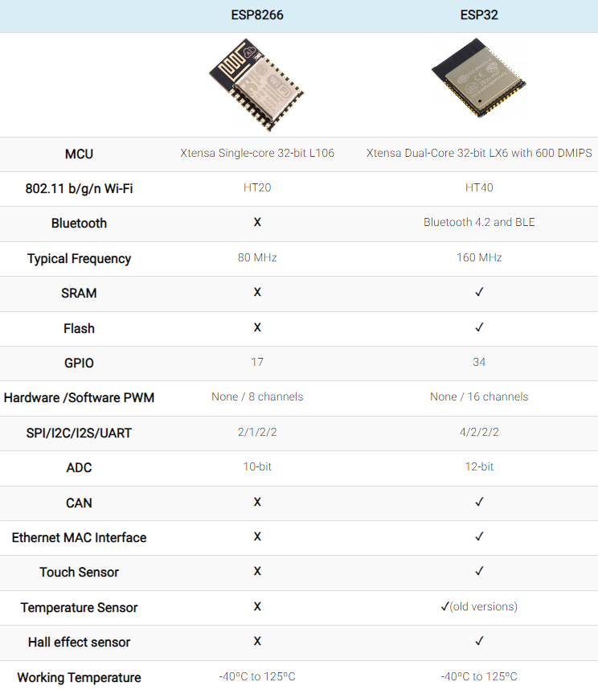
Why esp32?
Dual-Core Processor: ESP32 has a dual-core processor for multitasking, whereas ESP8266 is limited to a single core.
Bluetooth Support: ESP32 supports Bluetooth Classic and BLE, allowing versatile connectivity, while ESP8266 lacks Bluetooth.
Power Efficiency: ESP32 offers advanced deep sleep options, enhancing battery life. ESP8266 has fewer power management capabilities.
More GPIO and Peripherals: ESP32 has more GPIO pins and additional peripherals like ADC, DAC, and touch sensors, which ESP8266 lacks.
Enhanced Security: ESP32 includes hardware encryption and secure boot, while ESP8266 has limited security features.
Increased Memory: ESP32 has more RAM and Flash, enabling more complex applications compared to ESP8266's limited memory.
Analog and Digital Support: ESP32 offers multiple ADCs and DACs, whereas ESP8266 has only one ADC channel and no DAC

Slide 10
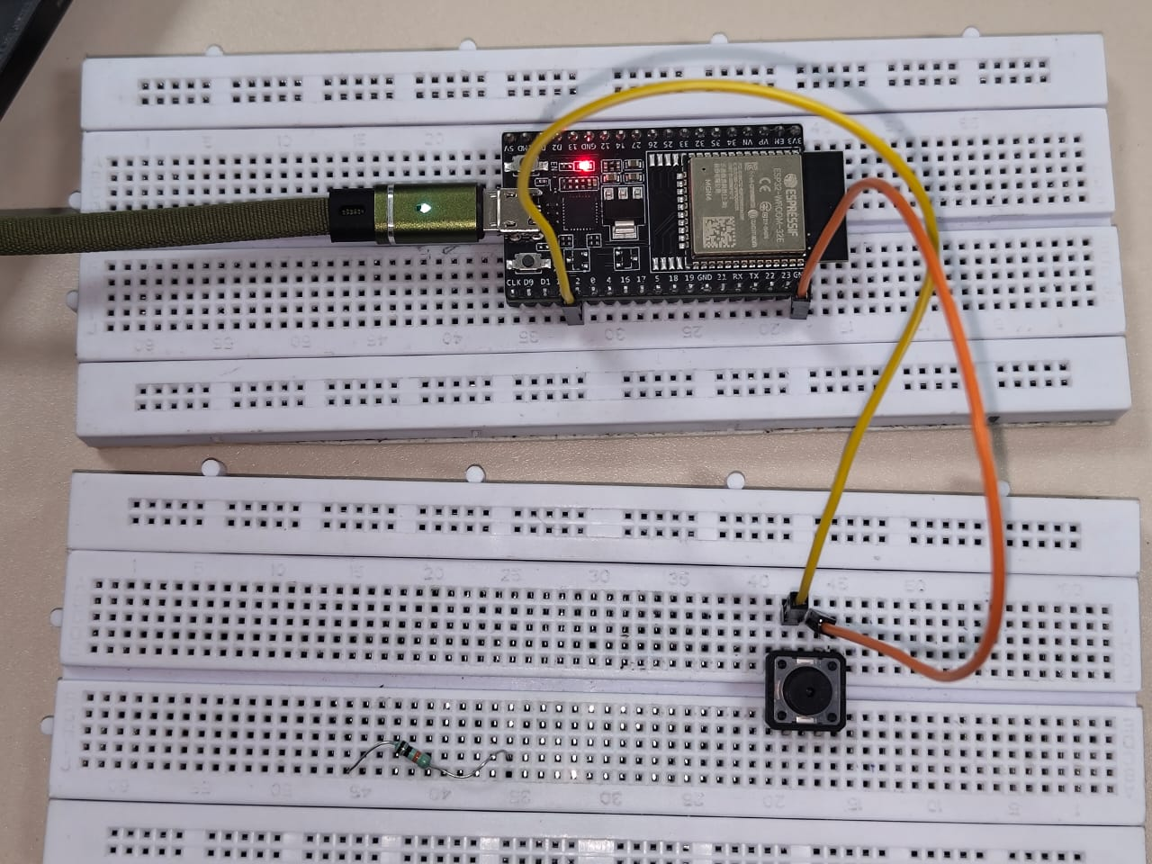
Components used
ESP32 Microcontroller
A Button(Panic button)
Wires for connection
Breadboard
API used
Twilio API for SMS communication

Slide 11
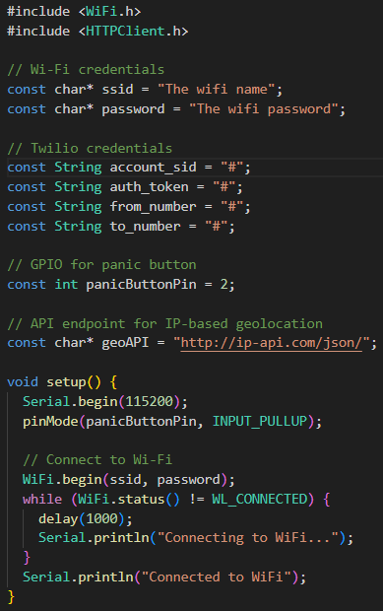
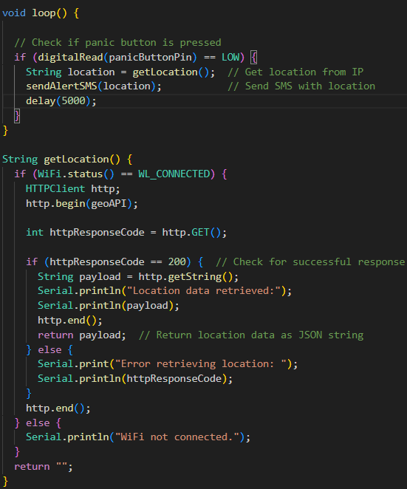
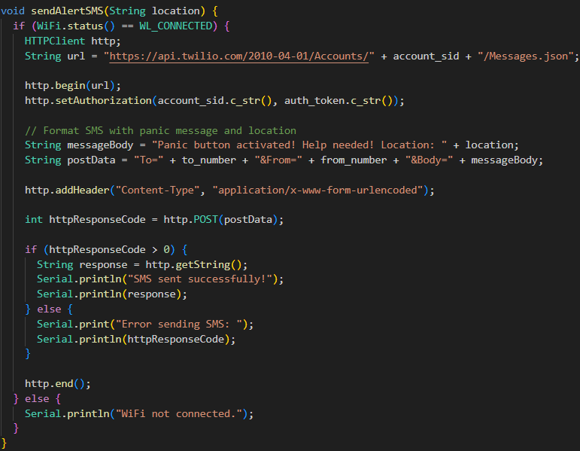
Project code

Slide 12
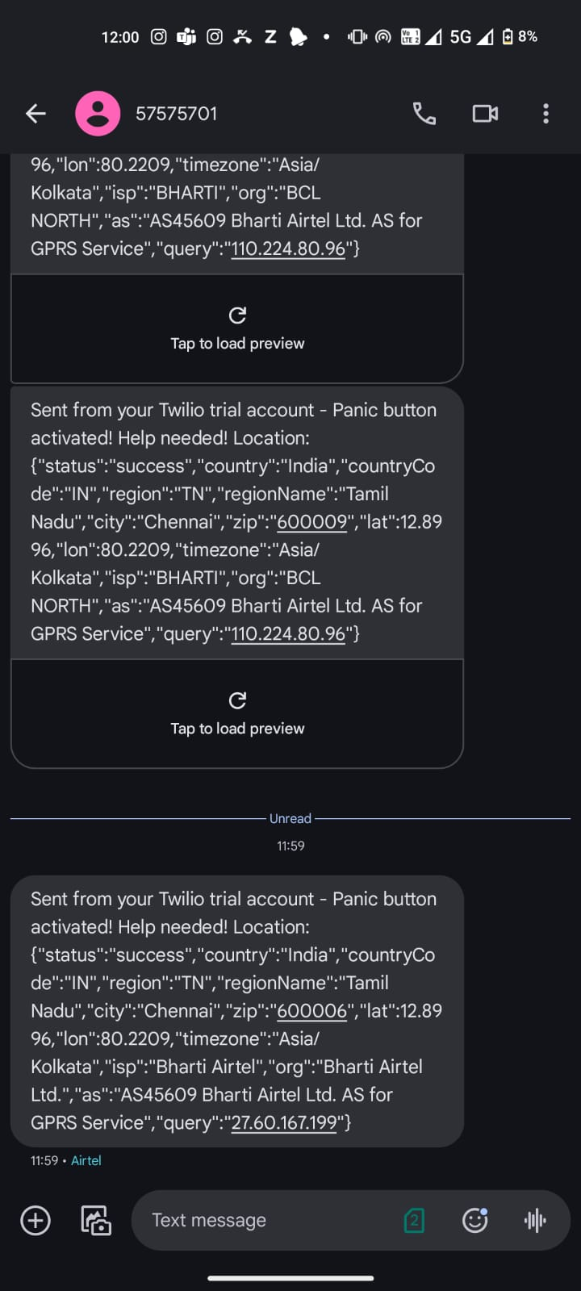
Flowchart of the Project
START
PRESS PANIC BUTTON
CHECK Wi-Fi Connection
OBTAIN LOCATION
PREPARE ALERT MSG
SEND ALERT MESSAGE
CONFIRM MESSAGE SENT
END

Slide 13
limitations
Predefined Contacts: Alerts are sent to predefined contacts, which may not always be reachable during emergencies.
User Dependency: Relies on the user to carry the device, keep it charged, and ensure it is ready for use.
No Fall Detection: Lacks sensors to detect falls or sudden movements that could trigger alerts automatically.
False Alarms: Accidental button presses or faulty wiring may lead to false alarms, potentially wasting emergency responders' time and resources.
Maintenance: The device requires regular maintenance, including checking the battery status, ensuring proper connectivity, and ensuring all components are functioning as expected.

Slide 14


Future scope
Additional Sensors:
The device could be enhanced with additional sensors like accelerometers or gyroscopes to detect falls or abnormal movements, automatically triggering the alert system.
Integrating the device into wearables:
Fusion of the device and wearables for stealth and better usability . ex: Adding into a necklace , ring etc.

Slide 15
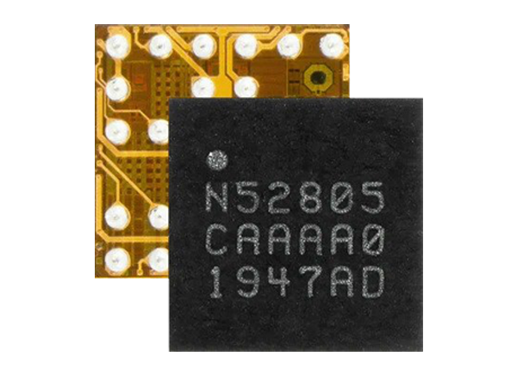
Future scope
Reducing the size of the project:
Integrating the Nordic Semiconductor nRF52805 (3.0mm x 3.0mm) into the women’s safety panic button project could significantly reduce the device's size, making it ideal for wearable applications like rings or pendants. With Bluetooth 5.1 (BLE), 2 GPIO pins, and low power consumption, the nRF52805 supports efficient communication while extending battery life.
While the chip’s limited resources may require optimizing the Bluetooth functionality, its simplicity and compactness can enhance device reliability and usability. Future improvements could include adding sensors (like fall detection) or improving real-time alerts without increasing size or complexity.

Slide 16
conclusion
This women’s safety panic button project using the ESP32 microcontroller offers an effective and accessible approach to personal safety. By leveraging Bluetooth technology, the device allows users to send their location and alert contacts during emergencies, without relying on network availability or mobile apps. Its simplicity and portability make it ideal for all user groups, including those with limited smartphone access.
This project demonstrates the power of embedded systems in solving real-world problems, providing a reliable safety tool. Future improvements could include direct GPS integration, vibration feedback, or linking with public safety networks.

Slide 17
references
S. Kaur and A. Mehta, "A Study on Smart Technologies for Women Safety," International Journal of Computer Applications, vol. 180, no. 12, 2017, pp. 15-20.D.
Gupta and P. Varshney, "Smart Technologies for Women Safety: Opportunities and Challenges," International Journal of Recent Trends in Engineering and Research, vol. 4, no. 7, 2018, pp. 39-44.
J. Sriram Pavan, et al. "Women Safety Device with GPS Tracking and Alerts Using Arduino." International Journal of Engineering Research & Technology (IJERT), vol. 7, no. 4, 2018, pp. 1-5.

Slide 18
Thank you !
Done by :
Tristan R P,112
Udhayam T D ,113
SriMithun A, 104

